Slide 1
Software Reuse
Software Design Architecture Lab # 11 Saniya Sarim

Slide 2
Software Reuse
Code reuse is the use of existing software to build new software. It is one of the holy grails of modern software development. APIs provide a mechanism to enable code reuse.
In the early years of software development, it was common for a company to have to write all of the code for any application they produced.
If the program needed to read GIF images or parse a text file, the company would have to write all that code in-house. Nowadays, with the proliferation of good commercial and open source libraries

Slide 3
Software Reuse
software development has become much more modular, with the use of distinct components that form the building blocks of an application and talk together via their published APIs.
The benefit of this approach is that you don't need to understand every detail of every software component, in the same way that for the earlier house building analogy you can delegate many details to professional contractors.
It also allows you to concentrate on your core business logic instead of having to spend time reinventing the wheel.

Slide 4
Software Reuse Examples
Api(Application Programming Interfaces). Google Apis(Maps, Cloud, Firebase, Drive … etc)
Shared Libraries
Plugins
Extensions: eg: (NewtonSoft Json) we have used in previous lectures task

Slide 5
Creating Reusable Software Example
In our example scenario we are building shared library project that performs basic calculation.
We will create two projects.
1st project contains calculation class that can be used for accounting in the project.
We will use this project in our 2nd project as DLL shared library for calculation purpose.

Slide 6
Example Step by Step

Slide 7
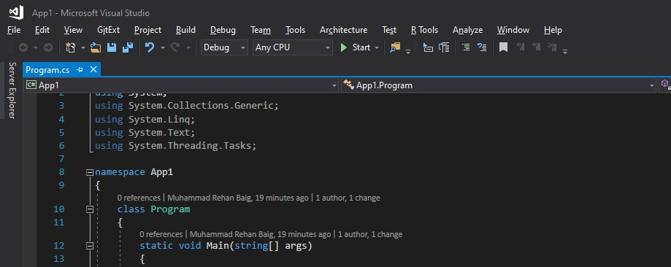
Step1 – Creating Project 1

Slide 8
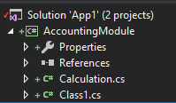
Step2 – Adding Class library Accounting as a Project in 1st Project for making Calculation DLL

Slide 9
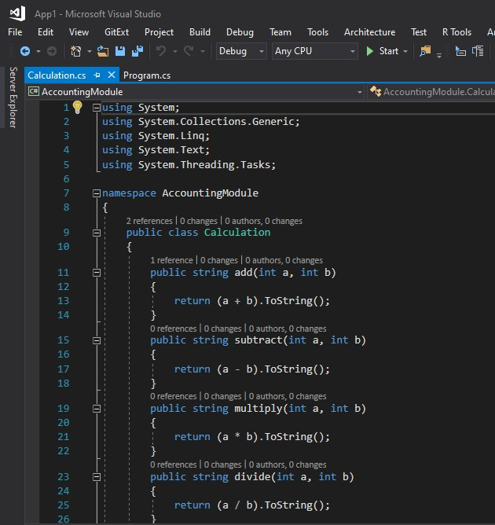
Step2 – Adding Class library Accounting as a Project in 1st Project for making Calculation DLL

Slide 10
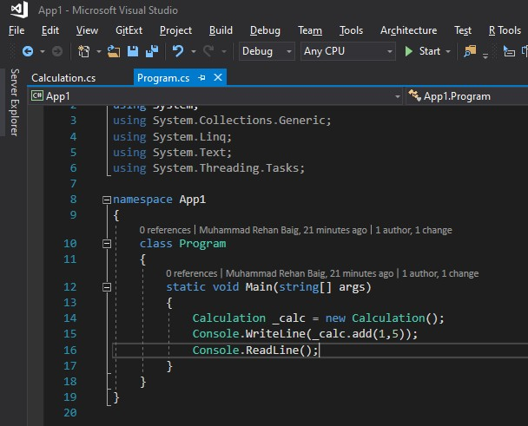
Step3 – Consuming App1 Accounting Calculation

Slide 11
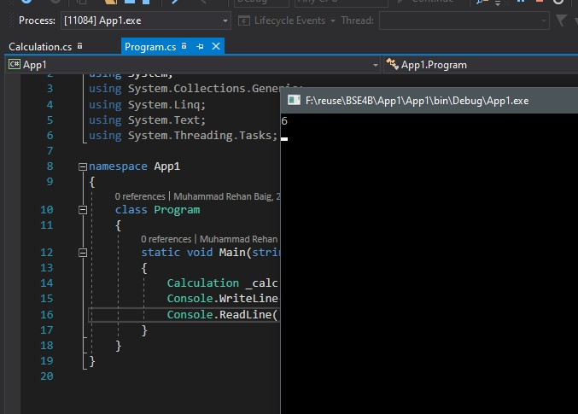
Output

Slide 12
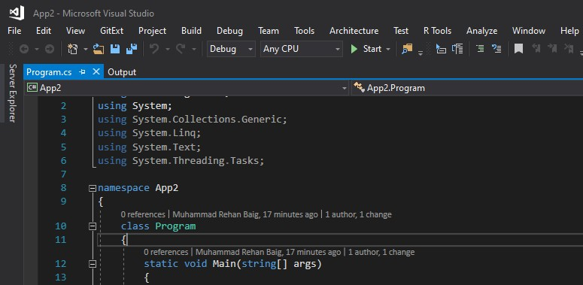
Step4 – Creating 2nd Project

Slide 13
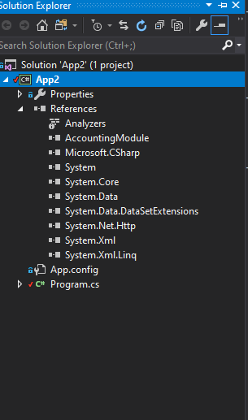
Step5 – Adding DLL (References) for Reuse of Calculation class
Adding Accounting from Project 1
As a Reference DLL
Shared Library

Slide 14
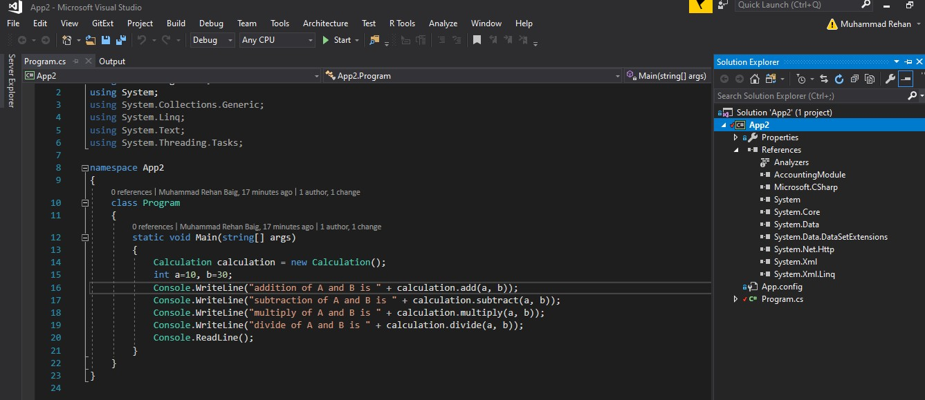
Step5 – Reuse Existing Code

Slide 15
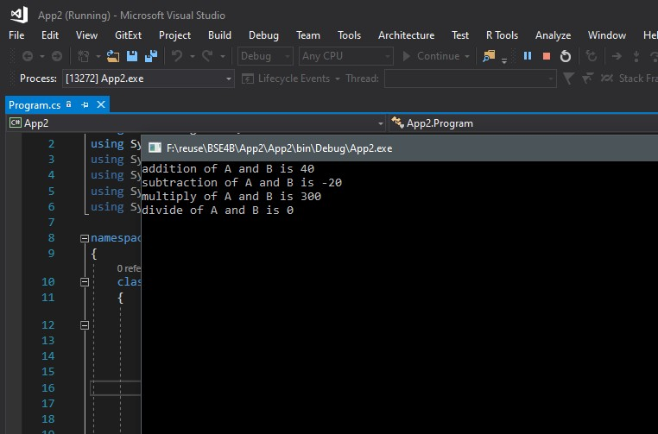
Output

Slide 16
Tasks
Create Reusable Code/Software for generating Marksheet of a student.
(Hint: Use Project 1 for calculation and Grading purpose)
Consume Google Maps Api in Html Webpage.

